Slide 1



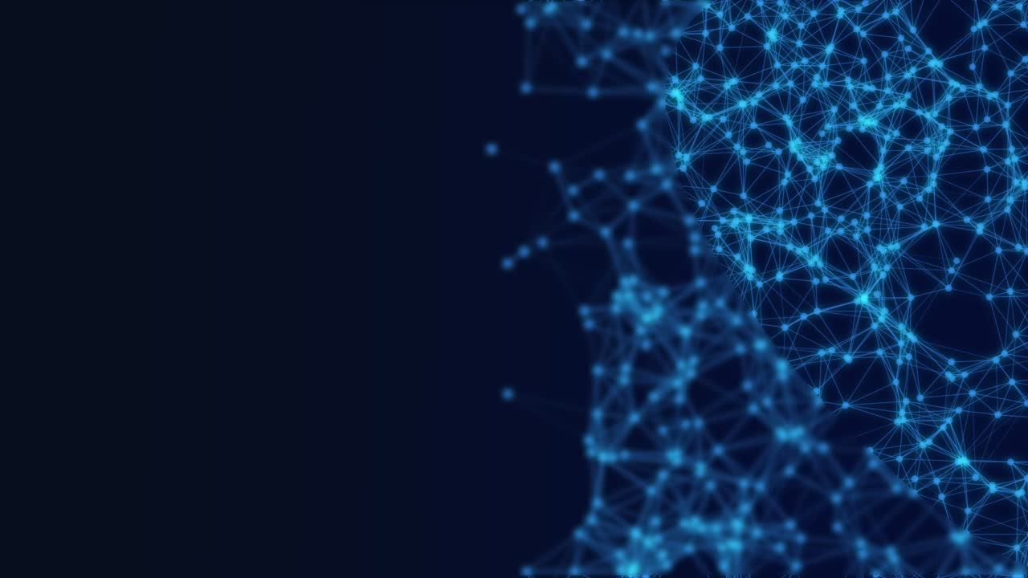
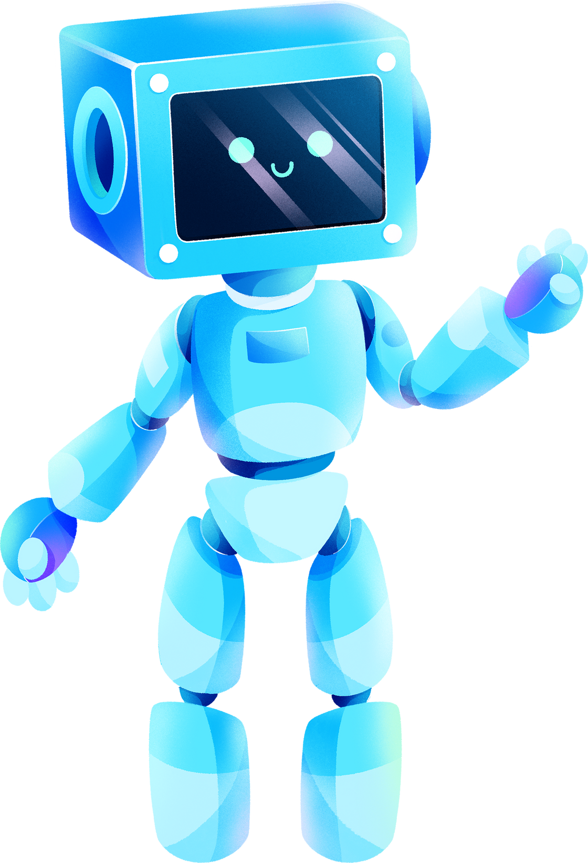
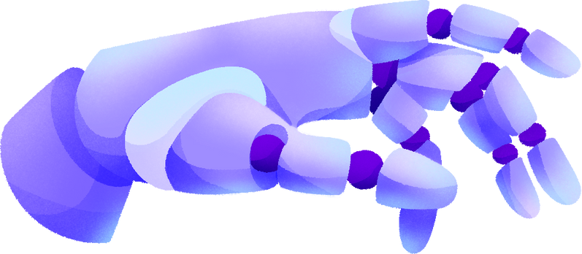
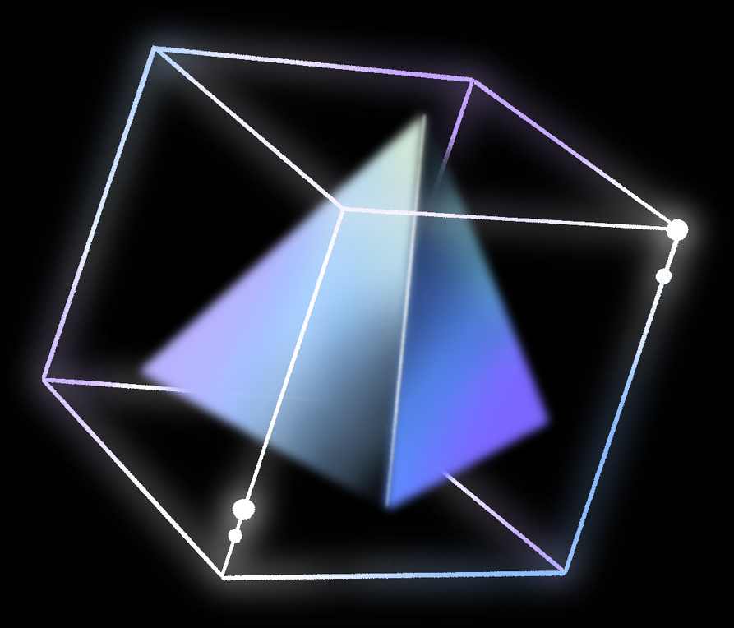
Catagories of
Artificial intelligence

Slide 2
Table of contents
What is AI?
where did it came from?
The classification
Conclusion

Slide 3
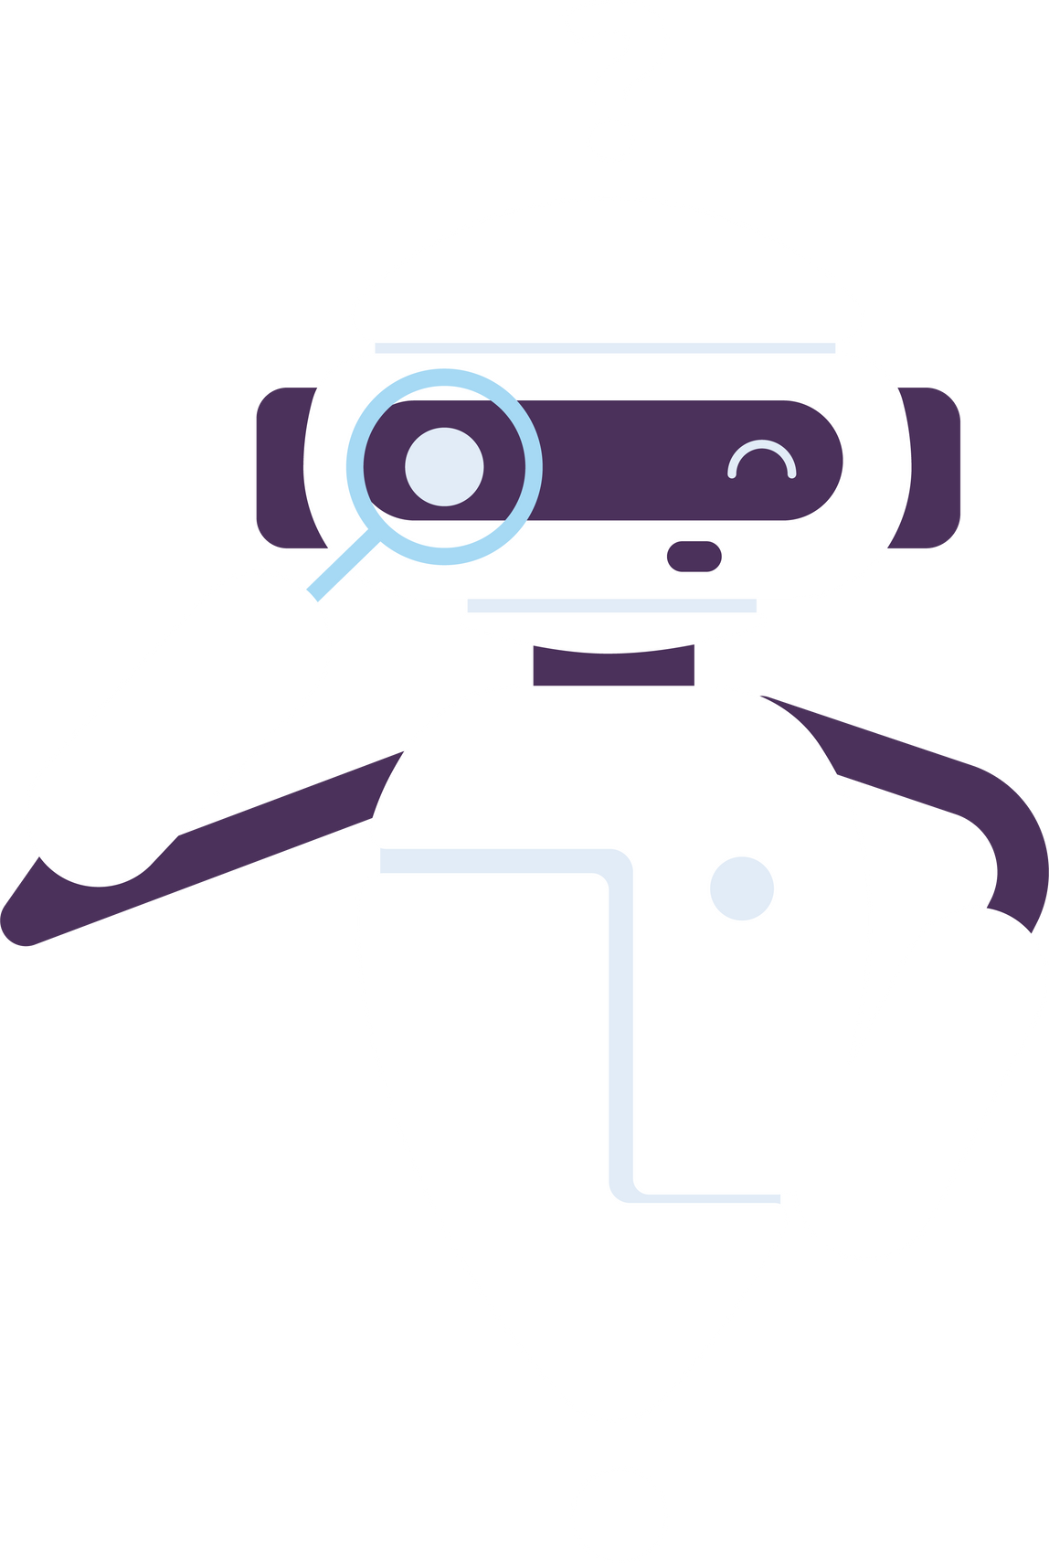
What is AI?🤔
Artificial Intelligence (AI) refers to the simulation of human intelligence in machines or computer systems. It involves creating algorithms and programs that enable computers to perform tasks that typically require human intelligence

Slide 4
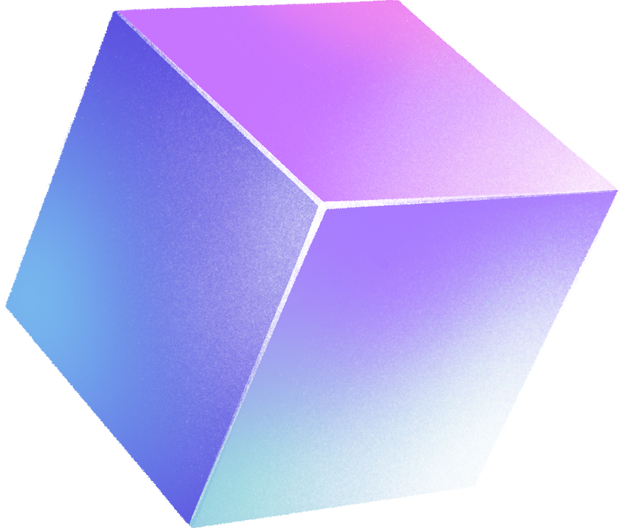
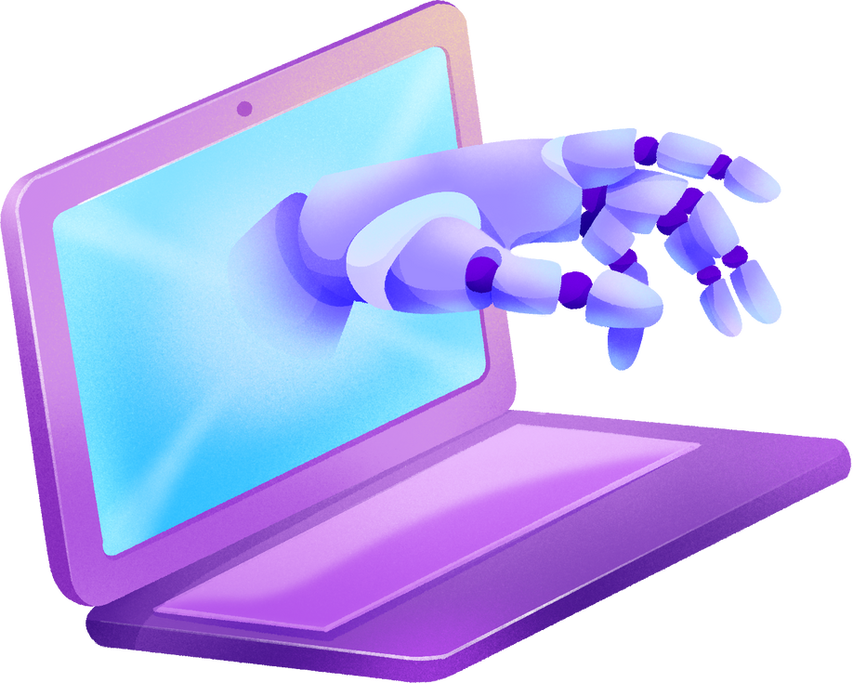
How did this all started?🤖
Sanskrit Grammar: Ancient Indian scholars developed structured rules and a formalized language, similar to modern programming languages.
Ancient Roots: Early AI concepts can be found in ancient mythology and folklore, with stories of human-like automatons and golems.
Early Mechanical Automata: In the 18th century, inventors like Jacques de Vaucanson created mechanical automata that mimicked human movements.
Alan Turing: Turing's work in the 20th century laid the theoretical foundation for AI, introducing the concept of the Turing Machine.
McCulloch and Pitts: They developed a mathematical model of a simplified neuron, contributing to neural network understanding.

Slide 5
How did this all started?🤖
.
Dartmouth Workshop (1956): Coined the term "Artificial Intelligence" and marked the birth of AI as a field.
Early AI Programs: Logic Theorist and General Problem Solver were among the earliest AI programs, capable of solving mathematical problems.
Expert Systems (1970s-1980s): These AI programs mimicked human decision-making in specific domains like medicine and finance.
AI Winters: Periods of reduced funding and interest in AI occurred in the 1970s, 1980s, and 1990s due to unmet expectations.
Recent Advances: AI resurged in the 21st century, with breakthroughs in machine learning and deep learning, leading to technologies like natural language processing and computer vision becoming ubiquitous.

Slide 6


Catagories of AI

Slide 7

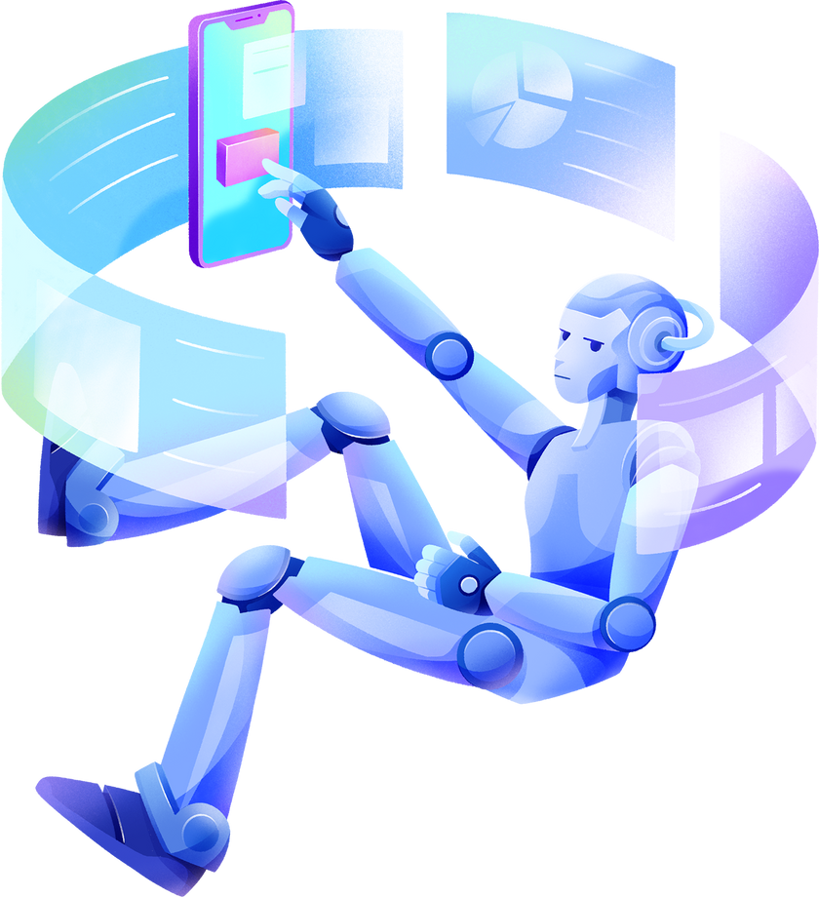


Based on Capabilities:
Narrow AI
General AI
Super AI

Slide 8
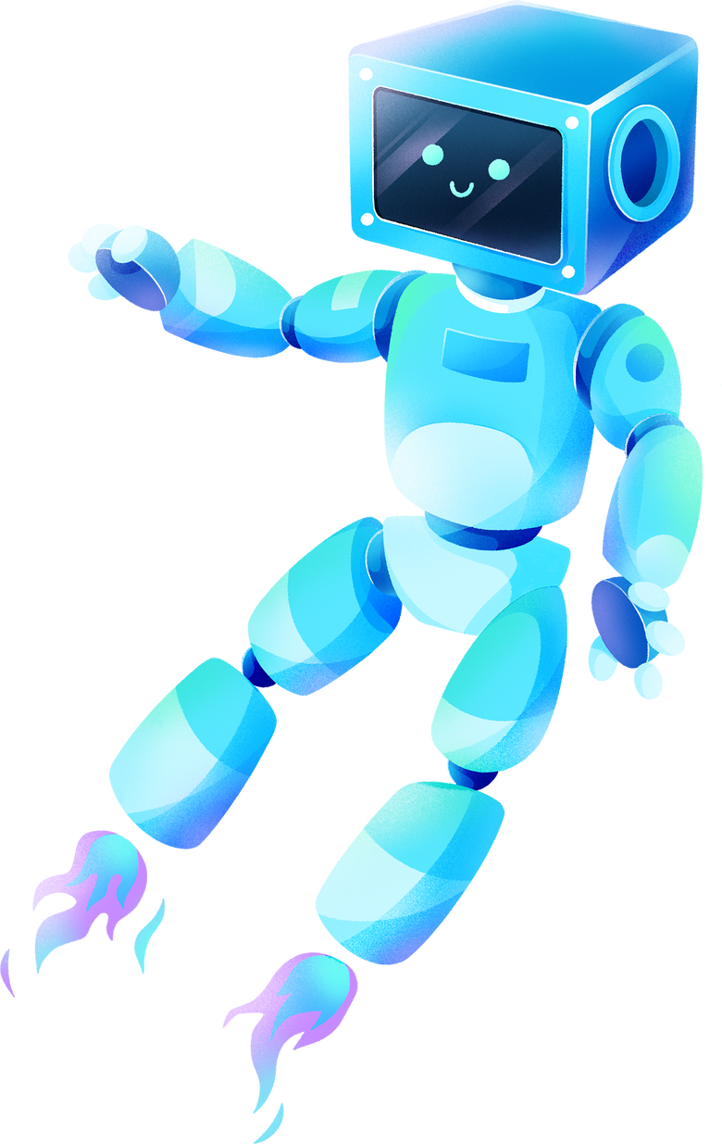
Based on Functionality
Reactive Machines
Limited Memory AI
AI with Theory of Mind
Self-Aware AI

Slide 9
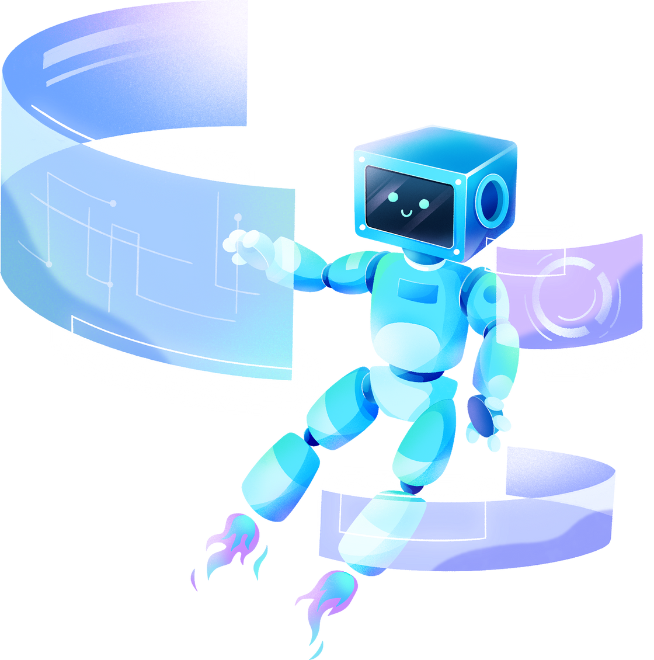
Thank you!

